Slide 1

TEAM ZERO STUDIOS

Slide 2
Problems
Aren’t you tired of going to the store to play lotto?
Aren’t you tired of waiting in long lines to play lotto?
Wouldn’t it be easier to play the lotto on the go?
Yes!

Slide 3

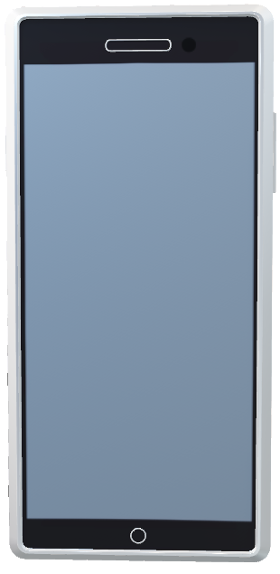
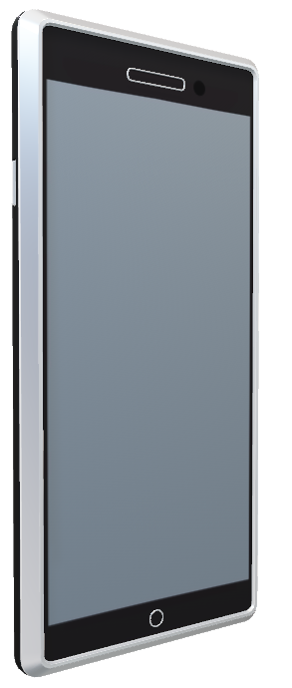
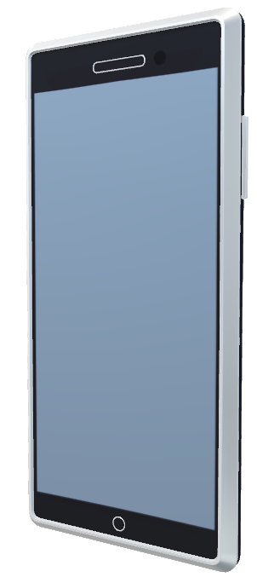
UPLAY Lottery

Slide 4
Objectives
Create Daily and Weekly Lottery Games
Multiple Game Mode support needed
Allow users to pick their numbers, or get random numbers via “Quick Pick”
Users can verify winning numbers and payout for winning
App works with Portrait and Landscape orientations

Slide 5
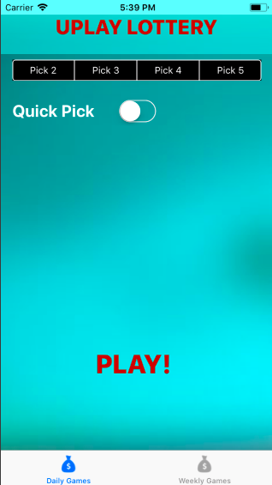
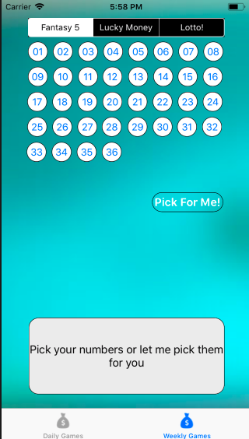


Daily and Weekly Lottery Games

Slide 6
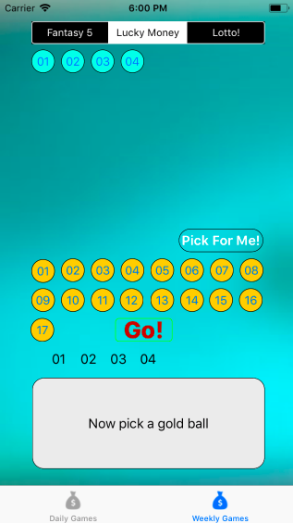
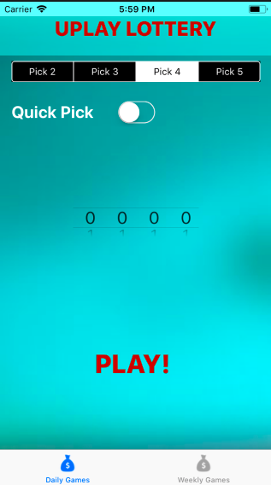
Multiple Game Mode support

Slide 7


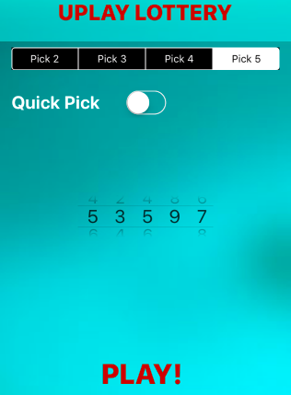
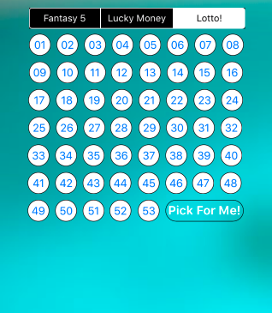
Users can pick numbers or use quick pick

Slide 8
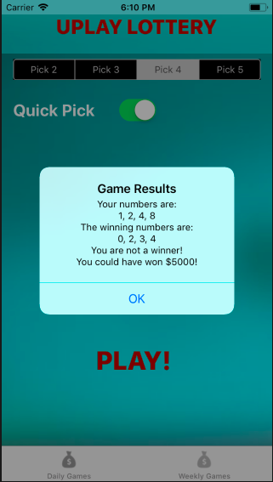
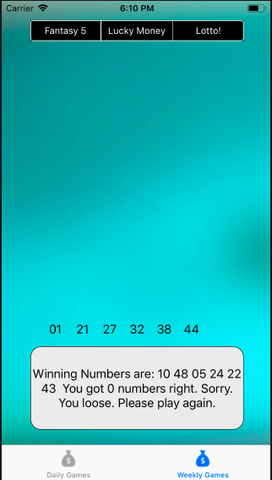
Instant verification - results and winnings

Slide 9
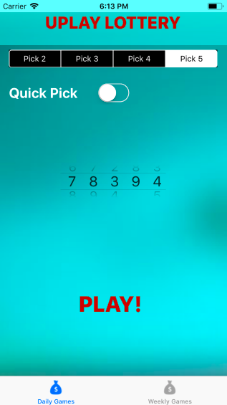
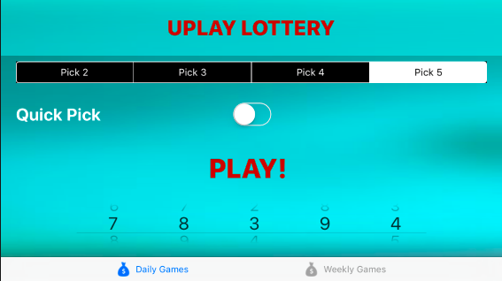
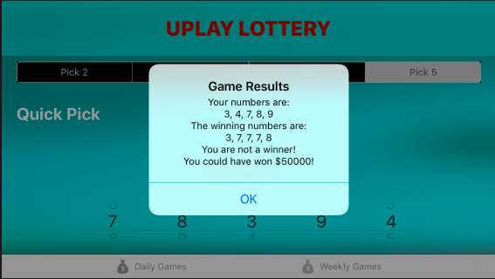
Support for Portrait and Landscape orientations

Slide 10
Get Lucky Today!
Download UPlay Lottery on your iPhone, and discover a better way to play

Slide 11
Team Zero Studios
Paul Christian
Matthew Schwartz
Al Mair
Albert Diaz
Brian Martinez

